Slide 1
MY PHOTOGRAPHY WEBSITE PROJECT

Slide 2
WHY A PHOTOGRAPHY WEBSITE?
Photography is a complex Language.
Photographs allow us to share & communicate.
Photographs has the power to move us.

Slide 3
MAIN FEATURES
Home
Gallery
People
Events
Animals
About
Booking
Services
Pricing
Contact

Slide 4
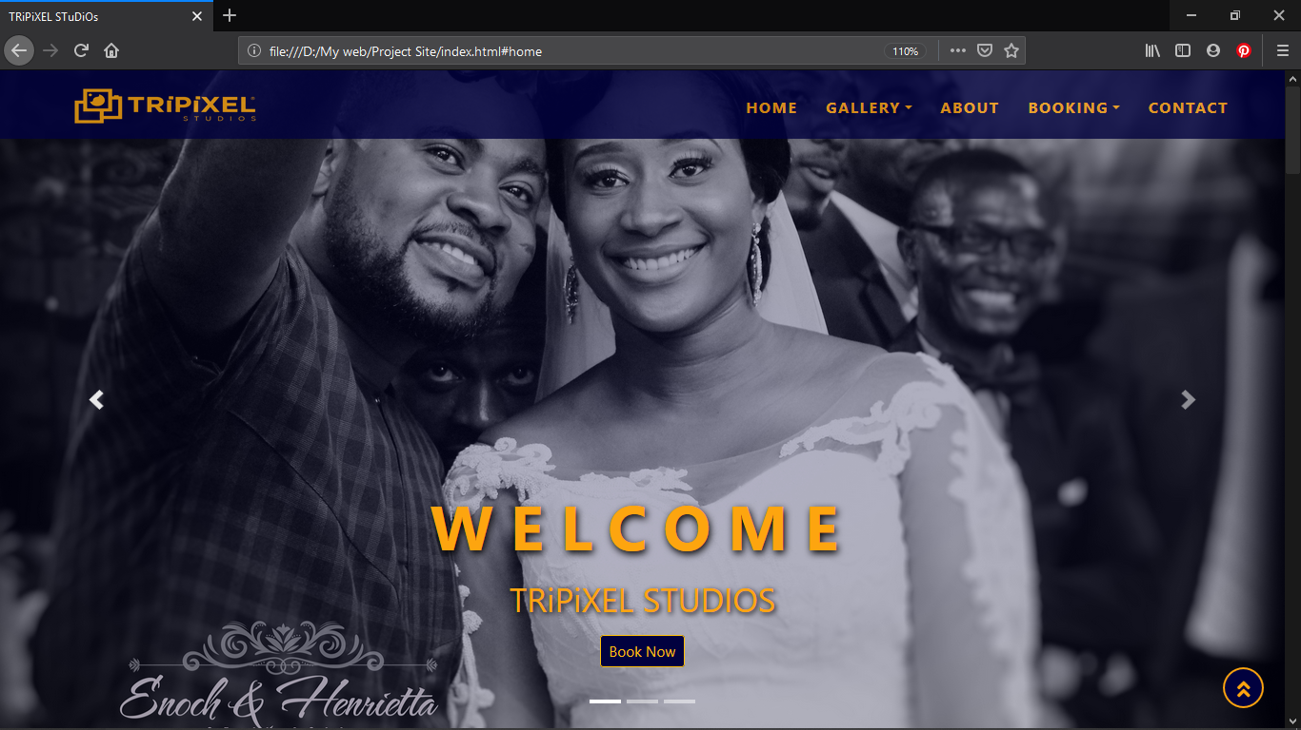
MAIN FEATURES (continuation)
HOME

Slide 5
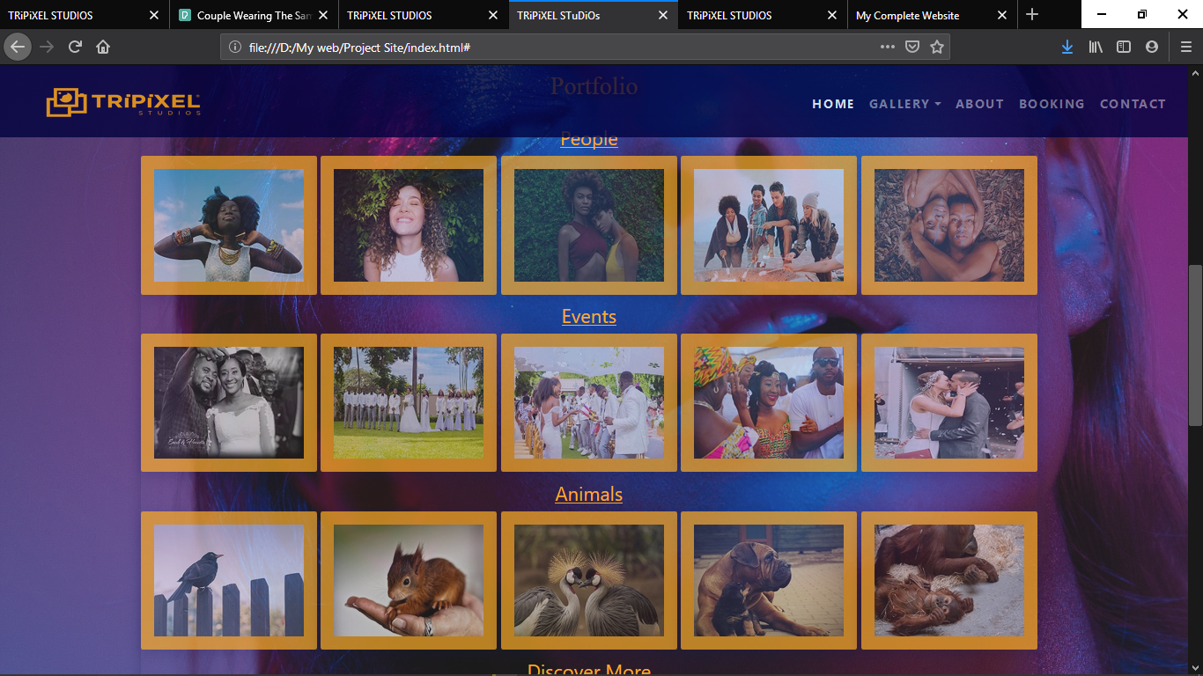

Gallery
People
Events
Animals

Slide 6
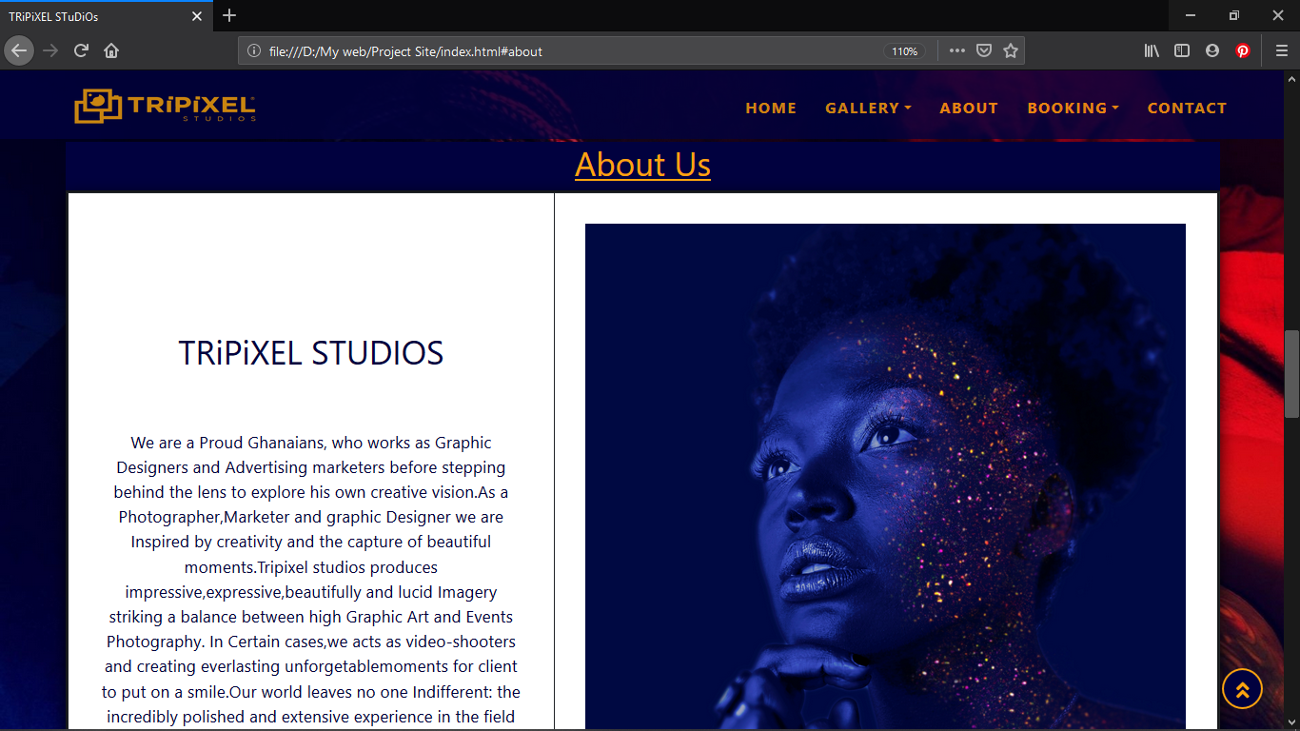
ABOUT

Slide 7
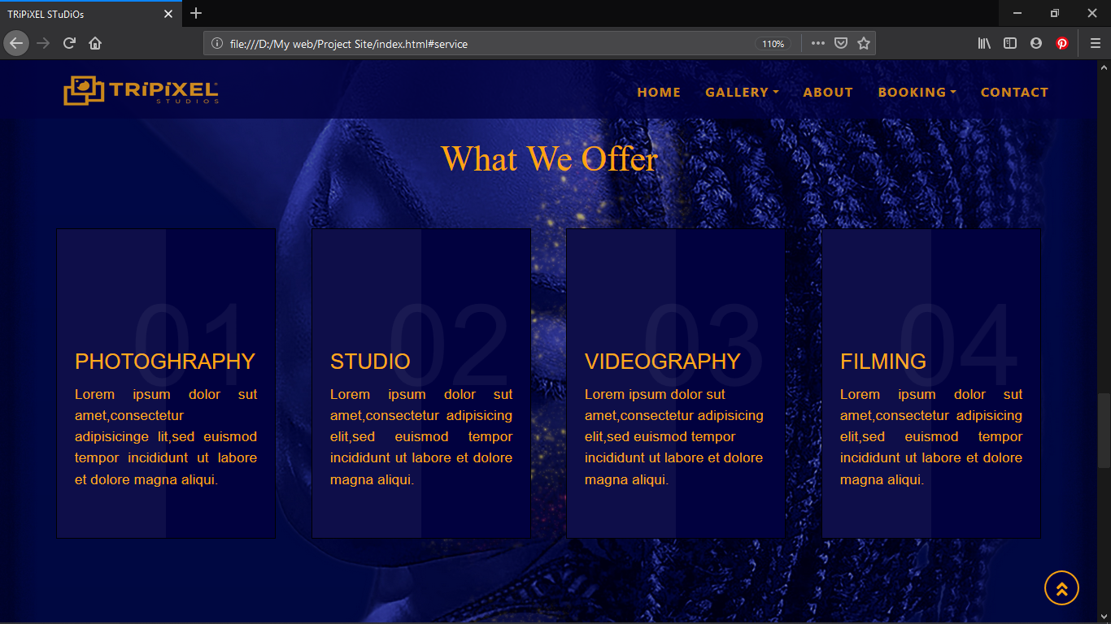
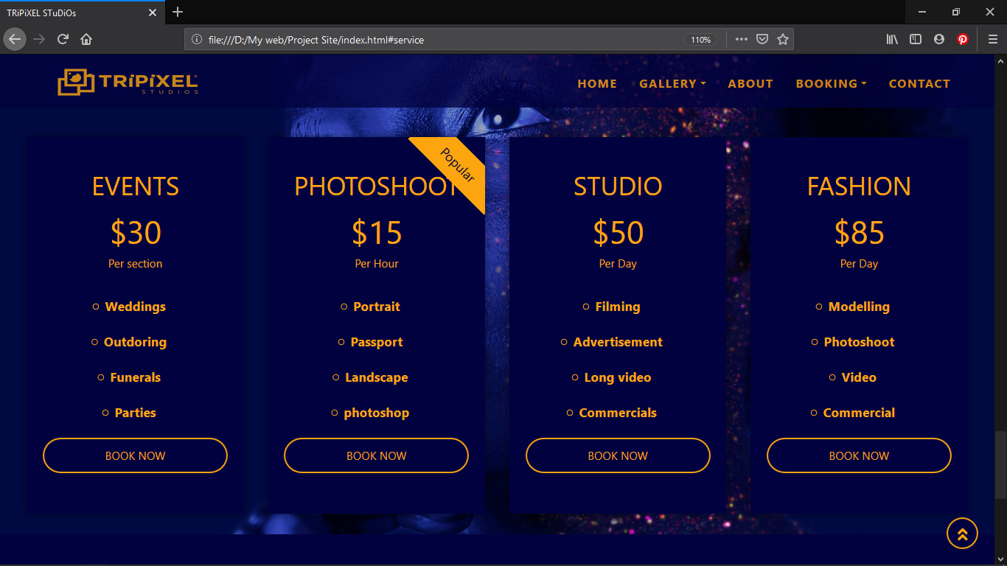
BOOKING
Services
Pricing

Slide 8
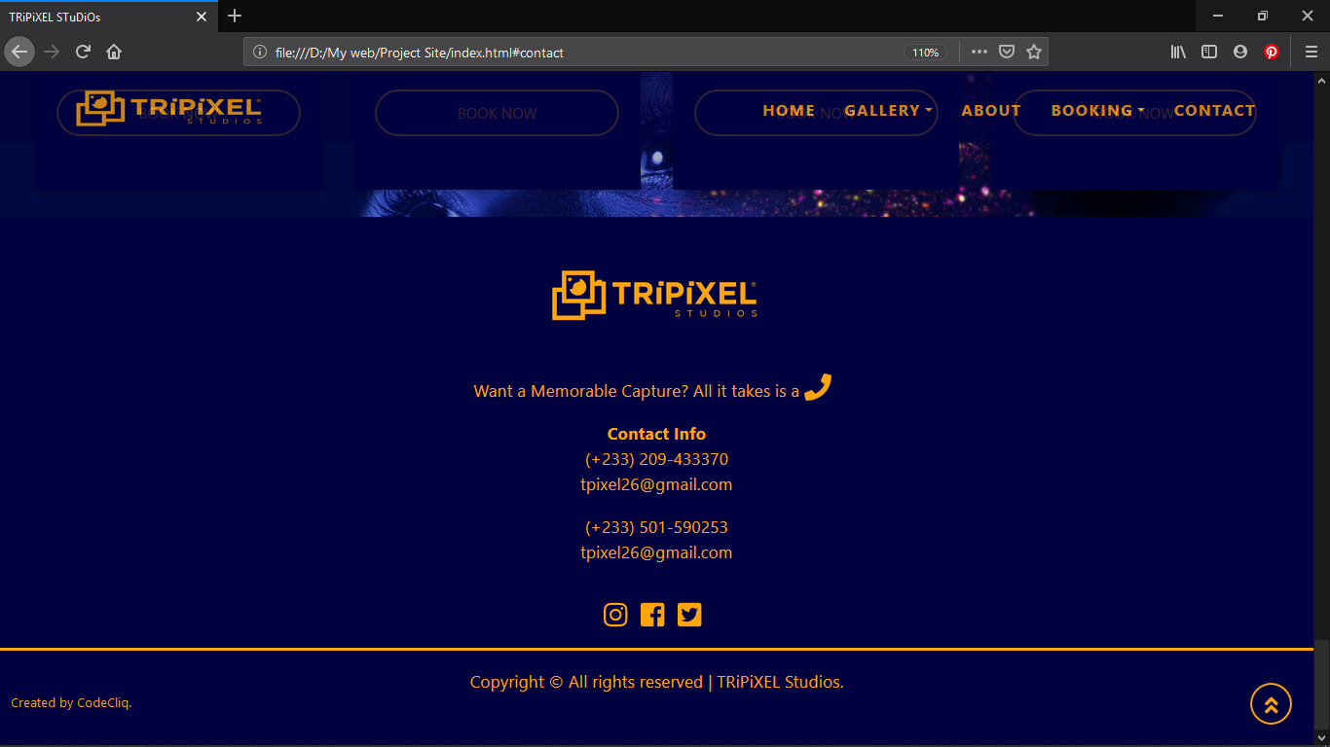
CONTACT

Slide 9
END OF PRESENTATION SLIDE

